Slide 1

Economics of Wound Management
Cost effective utilization of DNA sequencing in chronic wounds
Cesar S. Lozano, CWCMS,RVS,CWS,FACCWS

Slide 2
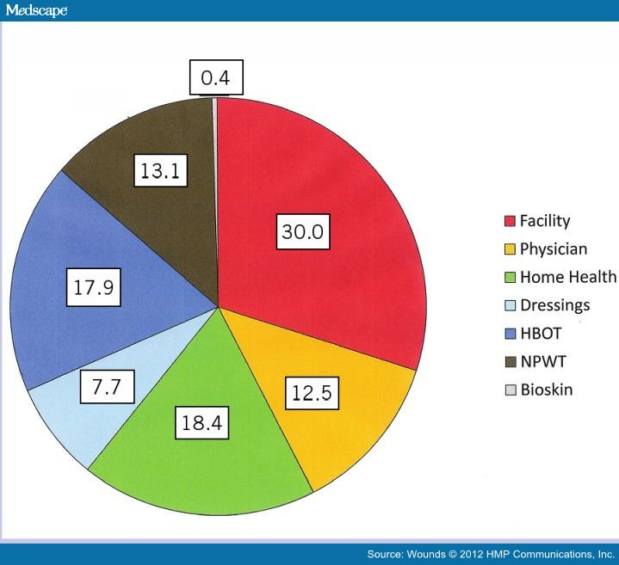
In the United States, chronic wounds affect around 9.5 million patients. ..... Wound infections are the most expensive complications following surgery .
The longer patients with non-healing wounds continue to be seen in the outpatient wound center, the greater their cost of care.

Slide 3
Treatment path/Costs Scale
The lower the wound severity (Prevention),the more effective standard of care will be. As wound/patient severity increase, so does the need or additional Costly therapies
Source Intellicure HER/Pathogenius Lab

Slide 4
Wellmed Clinics-HCD-WCC
Clinics provide basic wound care & antibiotic treatment if required. Cultures ordered.(DNA)
Patients referred to WCC are “lost”in the system. (ie.Modalities,HBO,Debridement.)
Complex wounds are referred to HCD for HHA services (DNA)
Patients in HHA follow POC as per MD, complex non-healing wounds referred back to MD or WCC. Infected wounds cultured. (DNA)
Costs keep increasing due to overutilization of topical products and modalities (WCC)

Slide 5
HCD-Admitted Wellmed Patients with Chronic Wounds
Dehisced Wounds
Pressure Ulcers
Venous Ulcers
Arterial Ulcers
Diabetic Foot Ulcers
Traumatic Wounds
Infected surgical wounds
*Admission from 01/01/15-09/01/15/Kinnser data.ICD9 does not provide codes to DFU/Arterial Ulcers

Slide 6
Economic Consequences of Non-Healing Wounds
Costs
Length of stay (LOS) Patient
Utilization of antibiotics, analgesics and wound therapies
Usage of biologics
Hospital readmissions
Wound recidivism (Relapse)
Cost of care in managing the patient
Surgical and diagnostic interventions
Research suggests that
an uncomplicated wound might Cost $8,000. Wounds that progressed to a higher severity experienced more than $17,000 in Higher costs than those that did not.
Ref.Stock

Slide 7
Molecular Diagnostics/DNA Sequencing
With molecular diagnostics, clinicians are able to know exactly which micro-organisms are present in any given wound. Once the pathogenic organisms are identified, medications can be selected and ratios adjusted to specifically address the individual wound bed, thereby allowing for a precise treatment that ultimately expedites healing -- 2 to 5 times faster in most cases.
99% of chronic wounds are poly-microbial, with high abundance levels.
- This means that there are almost always many different organisms present in a wound contributing to the infected state of a wound bed. The challenge here is that many of these microorganisms are very different from each other, and require special attention.
• Less than 5% of known wound microbes can be grown using traditional culture techniques
- This means that the majority of the microbes (over 95%) contributing to the community of organisms within the biofilm allowing the wound to persist will NOT be detected using traditional culture techniques.
- The limitations of traditional culture techniques lead to increased treatment cost through longer treatment times, more invasive medical interventions, and a higher incidence of progressed complications.
- Most importantly, this leads to increased pain and suffering.
• Molecular Diagnosis empowers the physician to treat the bio-burden with DNA level certainty.
• The microbial Bioburden is a significant barrier for all chronic wounds, regardless of etiology

Slide 8
Level 1 Report (24 Hrs.)
955799883-58716 Mata, Benancio | IV | PO | Topical
Generic |  |  |  |  | Streptococcus agalactiae- grp b | Staphylococcus aureus (mrsa)
 |  |  |  | Gram | + | +
 |  |  |  | Resp | FAn | FAn
clindamycin (Cleocin) | + | + | + |  | + | +
linezolid | + | + | + |  | + | +
nitrofurantoin |  | + |  |  | + | +
vancomycin | + |  | + |  | + | +
ampicillin | + | + |  |  | +
ceftriaxone | + |  |  |  | +
daptomycin | + |  |  |  |  | +
doripenem | + |  |  |  | +
doxycycline | + | + | + |  |  | +
fusidic acid (combo only) |  |  | + |  |  | +
levofloxacin | + | + |  |  | +
minocycline | + | + |  |  |  | +
revamping | + | + |  |  |  | +
tmp/smx (Bactrim) | + | + | + |  |  | +
Gram Stain +: Positive, -: Negative, I:Indeterminate, N: not applicable U: Unknown Respiration Ae: Aerobic, An: Anaerobic, FAn: Facultative anaerobic, Unk: Unknown
the actions of physicians, health care facilities and other users, and is not responsible for any injury, death or damage resulting from the use, misuse or interpretation of information obtained through this antibiotic report. Therapeutic options listed by the program are based upon national antibiotic susceptibility data and antibiograms. Therapy should not be undertaken without a thorough assessment of the indications, contraindications and side effects of any prospective drug or intervention. Furthermore, the database is curated and derived from incidence and prevalence statistics whose accuracy will vary widely for individual diseases and regions of the

Slide 9
Level 2 Report DeCodex (48-60 hrs)
955799883-58716 Mata, Benancio | IV | PO | Topical |  | 19 | 3 | 2 | 2 | 2 | 18 | 13 | 11 | 8 | 7
Generic |  |  |  |  | Fusobacterium nucleatum | Prevotella oris | Prevotella nigrescens | Peptostreptococcus stomatis | Parvimonas micra | Staphylococcus epidermidis (mrse) | Staphylococcus lugdunensis | Streptococcus anginosus | Staphylococcus aureus (mrsa) | Streptococcus intermedius
 |  |  |  | Gram | - | - | - | + | + | + | + | + | + | +
 |  |  |  | Resp | An | An | An | An | An | FAn | FAn | FAn | FAn | FAn
metronidazole | + | + | + |  | + | + | + | + | +
piperacillin/tazobactam | + |  | + |  | + | + | +
azithromycin | + | + |  |  | + |  | + | +
clindamycin (Cleocin) | + | + | + |  | + | + |  | + |  |  |  |  | +
colistimethate (colistin) | + |  | + |  |  | + | +
doripenem | + |  |  |  | + | +
cefuroxime | + |  |  |  |  |  | +
doxycycline | + | + | + |  | + |  |  |  |  |  |  |  | +
tetracycline |  | + |  |  |  |  | +
linezolid | + | + | + |  |  |  |  | + | + | + | + | + | + | +
vancomycin | + |  | + |  |  |  |  | + | + | + | + | + | + | +
amoxicillin |  | + |  |  |  |  |  | +
imipenem | + |  |  |  |  |  |  |  | +
moxifloxacin | + | + |  |  |  |  |  | + |  |  | +
daptomycin | + |  |  |  |  |  |  |  |  | + |  |  | +
ertapenem | + |  |  |  |  |  |  |  |  |  |  | + |  | +
levofloxacin | + | + |  |  |  |  |  |  |  |  |  | + |  | +
nitrofurantoin |  | + |  |  |  |  |  |  |  |  | + |  | +
penicillin g | + |  |  |  |  |  |  |  |  |  |  | + |  | +
rifampin | + | + |  |  |  |  |  |  |  | + |  |  | +
tmp/smx (Bactrim) | + | + | + |  |  |  |  |  |  |  | + |  | +
cefazolin | + |  |  |  |  |  |  |  |  |  | +
fusidic acid (combo only) |  |  | + |  |  |  |  |  |  |  |  |  | +
minocycline | + | + |  |  |  |  |  |  |  |  |  |  | +
Gram Stain +: Positive, -: Negative, I:Indeterminate, N: not applicable U: Unknown Respiration Ae: Aerobic, An: Anaerobic, FAn: Facultative anaerobic, Unk: Unknown
ANTIBIOTIC DISCLAIMER: Southwest Regional PCR assumes no liability to patients with respect to the actions of physicians, health care facilities and other users, and is not responsible for any injury, death or damage resulting from the use, misuse or interpretation of information obtained through this antibiotic report. Therapeutic options listed by the program are based upon national antibiotic susceptibility data and antibiograms. Therapy should not be undertaken without a thorough assessment of the indications, contraindications and side effects of any prospective drug or intervention. Furthermore, the database is curated and derived from incidence and prevalence statistics whose accuracy will vary widely for individual diseases and regions of the country. Changes in endemicity, incidence, and drugs of choice may occur. The list of drugs, infectious diseases and even country names will vary with time. Although we endeavor to include such new information on a timely basis, a delay cannot be avoided. For more information please contact us at 806.771.1134

Slide 10
Molecular Diagnostics
STANDARD OF CARE | GROUP 1 | GROUP 2
Traditional Culture with Systemic Antibiotics | Molecular Diagnostics with Systemic Antibiotics | Molecular Diagnostics with Customized Antibiotics
% of Patients Healed | % of Patients Healed | % of Patients Healed
48.5% 244/503 | 62.4% 298/479 | 90.4% 358/396

Slide 11
Median Number Days to heal by Wound Type
Wound Type | Standard of care Traditional Culture with PO Antibiotics | Group 1 DNA Diagnostics with PO Antibiotics | Group 2 DNA Diagnostics with customized Antibiotics
Pressure Ulcer | N/A | 107 | 28
Diabetic Foot Ulcer | 168 | 84 | 32
Non-Healing Surgical | 176 | 75 | 44
Traumatic Abscess | 39 | 33 | 14
Venous Ulcer | 177 | 98 | 37
Total | 177 | 77 (p<0.001) | 28 (p<0.001)

Slide 12
Costs Savings
Rapid results (24-48 hrs)
High sensitivity. (2500 microbes 1400 fungal)
High benefit to expense ratio (targeted approach)
Specificity and availability ( one small swab)
Panels are quantitative. (all % microbes)
Cost ( 20% over typical culture) all inclusive
These attributes all combine to make molecular methods most effective to diagnose poly-microbial and biofilm associated in clinical wound infections.

Slide 13
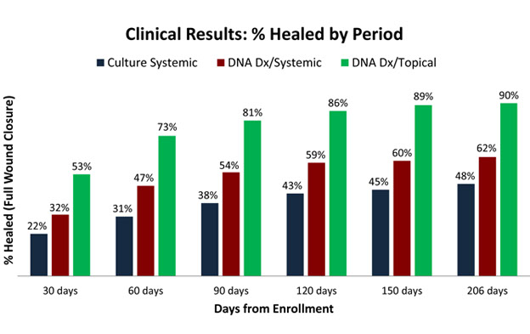
Outcomes
Ref. Pathogenius/Intellicure

Slide 14
References
Pathogenius Labs, Lubbock Texas
Wound Care Outcomes, Carolyn Fife, MD, CWS, Marissa J. Carter ,PhD,MA
Kinnser EMR, HCD
University Of Southern Indiana , School of Medicine
NPUAP/EUAP
1. Sen CK, Gordillo GM, Roy S, et al. Human skin wounds: a major and snowballing threat to public health and the economy. Wound Repair Regen. 2009;17(6):763–771. 2. Kuhn BA, Coulter SJ. Balancing ulcer cost and quality equation. Nurs Econ. 1992;10(5):353–359. 3. Hess CT. Putting the squeeze on venous ulcers. Nursing. 2004;34(Suppl Travel):8–13. 4. Driver VR, Fabbi M, Lavery LA, Gibbons G. The costs of diabetic foot: the economic case for the limb salvage team. J Am Podiatry Med Assoc. 2010;100(5):335–341. 5. Gordon MD, Gottschlich MM, Helvig EI, Marvin JA, Richard RL. Review of evidence-based practice for the prevention of pressure sores in burn patients. J Burn Care Rehabil. 2004;25(5):388–410. 6. Berry C, Murdoch DR, McMurray JJ. Economics of chronic heart failure. Eur J Heart Fail. 2001;3(3):283–291. 7. Carter MJ, Fife CE, Walker D, Thomson B. Estimating the applicability of wound care randomized controlled trials to general wound-care populations by estimating the percentage of individuals excluded from a typical wound-care population in such trials. Adv Skin Wound Care. 2009;22(7):316–324. 8. Institute of Medicine. Key Capabilities of an Electronic Health Record System (Electric Health Record Functional Model: Letter Report). Washington, DC: Institute of Medicine National Academies Press; 2003. 9. Gliklich RE, Dreyer NA, eds. Registries for Evaluating Patient Outcomes: A User’s Guide. AHRQ Publication No. 07-EHC001-1. Rockville, MD: Agency for Healthcare Research and Quality; 2007. 10. Concato J, Shah N, Horwitz RI. Randomized, controlled trials, observational studies, and the hierarchy of research designs. N Engl J Med. 2000;342(25):1887–1892. 11. Benson K, Hartz AJ. A comparison of observational studies and randomized, controlled trials. N Engl J Med. 2000;342(25):1878–1886. 12. Black N. Why we need observational studies to evaluate the effectiveness of health care

